Slide 1
Divide and Conquer Algorithms - 2
Md. Muktar Hossain
Lecturer
Dept. of CSE
Varendra university

Slide 2
Quick Sort
QuickSort is a highly efficient and widely-used sorting algorithm based on the Divide and Conquer that picks an element as a pivot and partitions the given array around the picked pivot by placing the pivot in its correct position in the sorted array.
Algorithm:
Choose the highest index value has pivot
Take two variables to point left and right of the list excluding pivot
Left points to the low index
Right points to the high
While value at left is less than pivot move right
While value at right is greater than pivot move left
If both step 5 and step 6 does not match swap left and right
If left ≥ right, the point where they met is new pivot
The step 1 to step 8 continues until the entire array is sorted.

Slide 3
Quick Sort Cont’d
void quickSort(int left, int right) {
if(right - left <= 0) {
return;
}
else {
int pivot = intArray[right];
int partitionPoint = partition(left, right, pivot);
quickSort(left, partitionPoint - 1);
quickSort(partitionPoint + 1,right);
}
}
45 | 23 | 28 | 72 | 18

Slide 4
Quick Sort Cont’d
void quickSort(int left, int right) {
if(right - left <= 0) {
return;
}
else {
int pivot = intArray[right];
int partitionPoint = partition(left, right, pivot);
quickSort(left, partitionPoint - 1);
quickSort(partitionPoint + 1,right);
}
}
45(L) | 23 | 28 | 72 | 18(R)
Pivot

Slide 5
Quick Sort Cont’d
45(L) | 23 | 28 | 72 | 18(R)
int partition(int left, int right, int pivot) {
int leftPointer = left -1;
int rightPointer = right;
while(true) {
while(intArray[++leftPointer] < pivot) { }
while(rightPointer > 0 && intArray[--rightPointer] > pivot) { }
if(leftPointer >= rightPointer) { break; }
else { swap(leftPointer, rightPointer); }
}
swap(leftPointer, right);
return leftPointer;
}
Pivot
lp
45 | 23 | 28 | 72 | 18(rp)
45(lp)(rp) | 23 | 28 | 72 | 18

Slide 6
Quick Sort Cont’d
45(L) | 23 | 28 | 72 | 18(R)
int partition(int left, int right, int pivot) {
int leftPointer = left -1;
int rightPointer = right;
while(true) {
while(intArray[++leftPointer] < pivot) { }
while(rightPointer > 0 && intArray[--rightPointer] > pivot) { }
if(leftPointer >= rightPointer) { break; }
else { swap(leftPointer, rightPointer); }
}
swap(leftPointer, right);
return leftPointer;
}
Pivot
lp
45 | 23 | 28 | 72 | 18(rp)
45(lp)(rp) | 23 | 28 | 72 | 18
18(pp) | 23 | 28 | 72 | 45

Slide 7
Quick Sort Cont’d
18(pp) | 23 | 28 | 72 | 45
void quickSort(int left, int right) {
if(right - left <= 0) {
return;
}
else {
int pivot = intArray[right];
int partitionPoint = partition(left, right, pivot);
quickSort(left, partitionPoint - 1);
quickSort(partitionPoint + 1,right);
}
}

Slide 8
Quick Sort Cont’d
18(pp) | 23 | 28 | 72 | 45
void quickSort(int left, int right) {
if(right - left <= 0) {
return;
}
else {
int pivot = intArray[right];
int partitionPoint = partition(left, right, pivot);
quickSort(left, partitionPoint - 1);
quickSort(partitionPoint + 1,right);
}
}

Slide 9
Quick Sort Cont’d
18(pp) | 23(L) | 28 | 72 | 45(R)
void quickSort(int left, int right) {
if(right - left <= 0) {
return;
}
else {
int pivot = intArray[right];
int partitionPoint = partition(left, right, pivot);
quickSort(left, partitionPoint - 1);
quickSort(partitionPoint + 1,right);
}
}

Slide 10
Quick Sort Cont’d
18 | 23(L) | 28 | 72 | 45(R)
void quickSort(int left, int right) {
if(right - left <= 0) {
return;
}
else {
int pivot = intArray[right];
int partitionPoint = partition(left, right, pivot);
quickSort(left, partitionPoint - 1);
quickSort(partitionPoint + 1,right);
}
}
Pivot

Slide 11
Quick Sort Cont’d
18 | 23(L) | 28 | 72 | 45(R)
int partition(int left, int right, int pivot) {
int leftPointer = left -1;
int rightPointer = right;
while(true) {
while(intArray[++leftPointer] < pivot) { }
while(rightPointer > 0 && intArray[--rightPointer] > pivot) { }
if(leftPointer >= rightPointer) { break; }
else { swap(leftPointer, rightPointer); }
}
swap(leftPointer, right);
return leftPointer;
}
Pivot
18(lp) | 23 | 28 | 72 | 45(rp)
18 | 23 | 28(rp) | 72(lp) | 45

Slide 12
Quick Sort Cont’d
18 | 23(L) | 28 | 72 | 45(R)
int partition(int left, int right, int pivot) {
int leftPointer = left -1;
int rightPointer = right;
while(true) {
while(intArray[++leftPointer] < pivot) { }
while(rightPointer > 0 && intArray[--rightPointer] > pivot) { }
if(leftPointer >= rightPointer) { break; }
else { swap(leftPointer, rightPointer); }
}
swap(leftPointer, right);
return leftPointer;
}
Pivot
18(lp) | 23 | 28 | 72 | 45(rp)
18 | 23 | 28(rp) | 72(lp) | 45
18 | 23 | 28 | 45(pp) | 72

Slide 13
Quick Sort Cont’d
18 | 23(L) | 28(R) | 45(pp) | 72
void quickSort(int left, int right) {
if(right - left <= 0) {
return;
}
else {
int pivot = intArray[right];
int partitionPoint = partition(left, right, pivot);
quickSort(left, partitionPoint - 1);
quickSort(partitionPoint + 1,right);
}
}

Slide 14
Quick Sort Cont’d
18 | 23(L) | 28(R) | 45(pp) | 72
void quickSort(int left, int right) {
if(right - left <= 0) {
return;
}
else {
int pivot = intArray[right];
int partitionPoint = partition(left, right, pivot);
quickSort(left, partitionPoint - 1);
quickSort(partitionPoint + 1,right);
}
}
Pivot

Slide 15
Quick Sort Cont’d
18 | 23(L) | 28(R) | 45 | 72
int partition(int left, int right, int pivot) {
int leftPointer = left -1;
int rightPointer = right;
while(true) {
while(intArray[++leftPointer] < pivot) { }
while(rightPointer > 0 && intArray[--rightPointer] > pivot) { }
if(leftPointer >= rightPointer) { break; }
else { swap(leftPointer, rightPointer); }
}
swap(leftPointer, right);
return leftPointer;
}
Pivot
18(lp) | 23 | 28(rp) | 45 | 72
18 | 23(rp) | 28(lp) | 45 | 72

Slide 16
Quick Sort Cont’d
18 | 23(L) | 28(R) | 45 | 72
int partition(int left, int right, int pivot) {
int leftPointer = left -1;
int rightPointer = right;
while(true) {
while(intArray[++leftPointer] < pivot) { }
while(rightPointer > 0 && intArray[--rightPointer] > pivot) { }
if(leftPointer >= rightPointer) { break; }
else { swap(leftPointer, rightPointer); }
}
swap(leftPointer, right);
return leftPointer;
}
Pivot
18(lp) | 23 | 28(rp) | 45 | 72
18 | 23(rp) | 28(lp) | 45 | 72
18 | 23 | 28(pp) | 45 | 72

Slide 17
Quick Sort Cont’d
void quickSort(int left, int right) {
if(right - left <= 0) {
return;
}
else {
int pivot = intArray[right];
int partitionPoint = partition(left, right, pivot);
quickSort(left, partitionPoint - 1);
quickSort(partitionPoint + 1,right);
}
}
18 | 23 | 28(pp) | 45 | 72
18 | 23(L)(R) | 28(pp) | 45 | 72

Slide 18
Quick Sort Cont’d
18 | 23(L)(R) | 28(pp) | 45 | 72
void quickSort(int left, int right) {
if(right - left <= 0) {
return;
}
else {
int pivot = intArray[right];
int partitionPoint = partition(left, right, pivot);
quickSort(left, partitionPoint - 1);
quickSort(partitionPoint + 1,right);
}
}
18 | 23 | 28(pp)(R) | 45 | 72

Slide 19
Quick Sort Cont’d
18 | 23 | 28(pp)(R) | 45 | 72
void quickSort(int left, int right) {
if(right - left <= 0) {
return;
}
else {
int pivot = intArray[right];
int partitionPoint = partition(left, right, pivot);
quickSort(left, partitionPoint - 1);
quickSort(partitionPoint + 1,right);
}
}

Slide 20
Quick Sort Cont’d
18 | 23 | 28(pp)(R) | 45 | 72
void quickSort(int left, int right) {
if(right - left <= 0) {
return;
}
else {
int pivot = intArray[right];
int partitionPoint = partition(left, right, pivot);
quickSort(left, partitionPoint - 1);
quickSort(partitionPoint + 1,right);
}
}

Slide 21
Quick Sort Cont’d
18 | 23 | 28 | 45(pp) | 72(R)
void quickSort(int left, int right) {
if(right - left <= 0) {
return;
}
else {
int pivot = intArray[right];
int partitionPoint = partition(left, right, pivot);
quickSort(left, partitionPoint - 1);
quickSort(partitionPoint + 1,right);
}
}
18 | 23 | 28 | 45(pp) | 72(L)(R)

Slide 22
Quick Sort Cont’d
void quickSort(int left, int right) {
if(right - left <= 0) {
return;
}
else {
int pivot = intArray[right];
int partitionPoint = partition(left, right, pivot);
quickSort(left, partitionPoint - 1);
quickSort(partitionPoint + 1,right);
}
}
18 | 23 | 28 | 45(pp) | 72(L)(R)
18 | 23 | 28 | 45 | 72

Slide 23
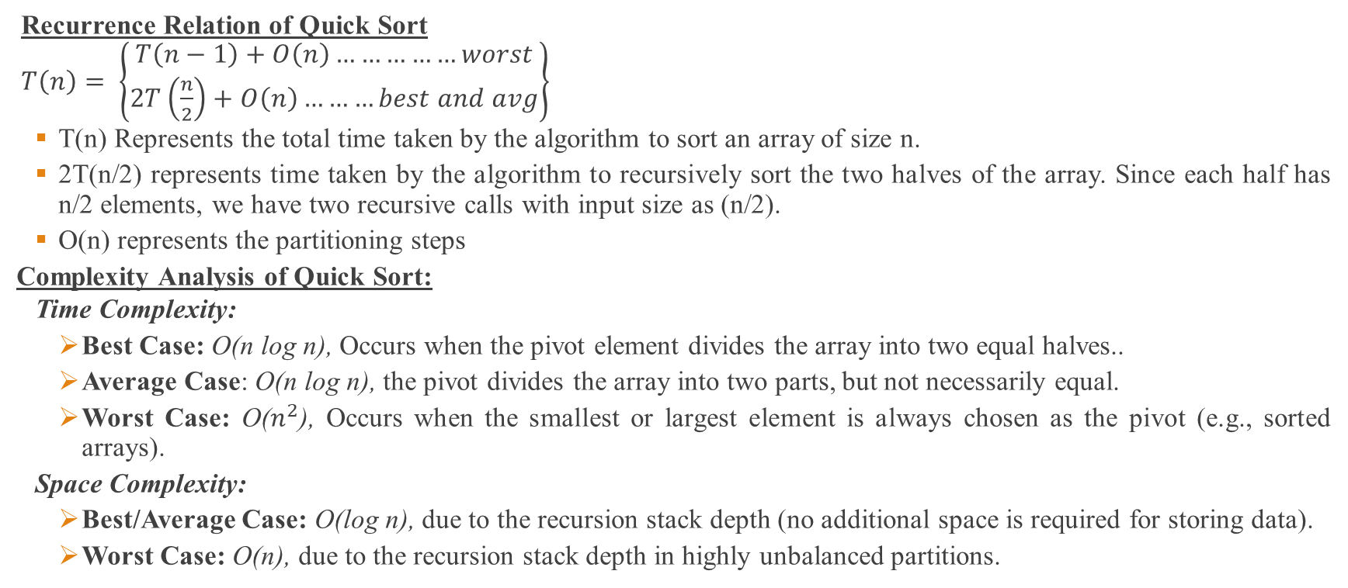
Quick Sort Cont’d
Recurrence Relation of Quick Sort
$T\left(n\right)= \left\{\begin{aligned}T\left(n−1\right)+O\left(n\right)……………worst \\ 2T\left(\frac{n}{2}\right)+O\left(n\right)………best and avg\end{aligned}\right\}$
T(n) Represents the total time taken by the algorithm to sort an array of size n.
2T(n/2) represents time taken by the algorithm to recursively sort the two halves of the array. Since each half has n/2 elements, we have two recursive calls with input size as (n/2).
O(n) represents the partitioning steps
Complexity Analysis of Quick Sort:
Time Complexity:
Best Case: O(n log n), Occurs when the pivot element divides the array into two equal halves..
Average Case: O(n log n), the pivot divides the array into two parts, but not necessarily equal.
Worst Case: O($n^{2}$), Occurs when the smallest or largest element is always chosen as the pivot (e.g., sorted arrays).
Space Complexity:
Best/Average Case: O(log n), due to the recursion stack depth (no additional space is required for storing data).
Worst Case: O(n), due to the recursion stack depth in highly unbalanced partitions.

Slide 24
Thank You

